Slide 1
EEG HETERODYNING
The Science of Mind Manipulation
Robert Duncan
Notes:
Motivation for presentation: Vacation and to inspire new ideas for jamming, testing, and shielding. Give you some food for thought.
My expertise is in neural controls, pattern recognition, optimization algorithms, and mind control.
If you want a copy of the presentation, grab a business card and send me an email. There are a couple published books if you are a TI out there.
This is a treat for those who are advanced in neuroscience. I often get asked questions about the technology but it cannot be described in a simple answer. It is the culmination of all human knowledge to date and spans many fields of study. It is far more complex than a simple atomic bomb as a weapon of mass destruction.
I got interested in psychology and physics due to magic. I saw Criss Angel last night.
All fields of study are derived from these two basic studies. And I will claim that the subject and objective will eventually be merged into a new field of psychophysics or neuropsychology. This is where my interest in artificial intelligence emerged.

Slide 2
What is EEG Heterodyning?
Electro-encephalographic heterodyning (EEG heterodyning)
Mixing brain signals
Definitions: The brain is the hardware. The mind is the software
Disagreements about the sense of self or even the tree of life, it is about humans oversimplifying to classify and categorize in digital understanding. It is like with quantum theory that everything is both a wave and a particle. Analogue and digital.
Current Purposes: Interrogate, spy, kill, disable target, practice, collect efficacy data, incorporate cognitive models of language
Notes:
Let me define these terms.

Slide 3
What is EEG cloning vs. Heterodyning?
Cloning is a specific case of heterodyning. 100% influence over the target mind (human robot) or vice versa (silent spy mode).
For now EEG cloning requires a live person to person interface
Heterodyning techniques often use AI (artificial intelligence)
Notes:
5% of population hear voices but only a small few are tortured. Minimum 10,000 worldwide that have come forward.
Even the fastest computers can only simulate 1 second of brain activity in 40 minutes. Japan
Human brain still remain the fastest computers we know but not for long
Here is an interesting calculation: 7 billion human minds times 2,000 maximum brain wave frequencies/cycles per second. This is well within a super computers range to model the entire human race. However this requires models for every variation of brains to interpret the signals.
Hence EEG cloning requires a live person to person interface for now. This is why Tis say sometimes it is a real person and other times it is a repetitive AI programs.
What is learning? What is intelligence?
Advances in knowledge transfer. This could be how to drive a car, do differential equations, or for punishment to do a 10 years prison sentence in one week
Alters reality. We develop our models of reality since birth. It has helped us for survival to explain the past and predict the future.

Slide 4
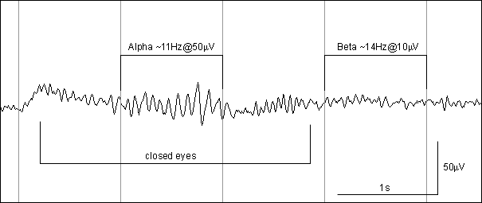
What does it look like?
Notes:
stimulus and response, the brains learn each other's patterns or just one way
transmission of senses and experiences. One is looking for the brain/head echo effect through reptilians of patterns.
You can drive someone to madness or train them to fly a plane or even learn a new language. accelerated learning
worked on paper using a priori knowledge of one neural net to another in which it could generalize
Small little nudges in frequency and macro-circuit timings in order to align them. The same functions in states within the brain give rise to the roughly the same subjective experience within the species to genetic structure of the brain. It takes time for the nuances to correct themselves.
Why do real Tis experience flashing in their vision, pulsing in their bodies, tinnitus around 3.3 hertz? These are entrainment frequencies for alignment and further “learning” of the minds.

Slide 5
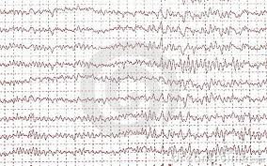
What does it look like? Cont.
RHIC – remote hypnotic intercerrebral control
Notes:
Graph of Heterodyning, time slicing or running multiple personalities on one brain
Show misaligned signals and why hypnotic alignment pulses are needed during cloning process during macro circuit learning. The cerebral cortex is where all the information is interpreted. The entire brain does not need to be modeled, only the higher functions hijacked. RHIC
Frequency follows response.
Binaural beats can entrain a brain or even strobe lights.
If you want to prove EEG heterdyning it requires some very specialized signal intelligence expertise. You must show across the entire power spectrum a correlation to brain state changes. The equipment if very expensive. You must look at narrow band, ultrawide band, and everything in between in the spectrum.

Slide 6
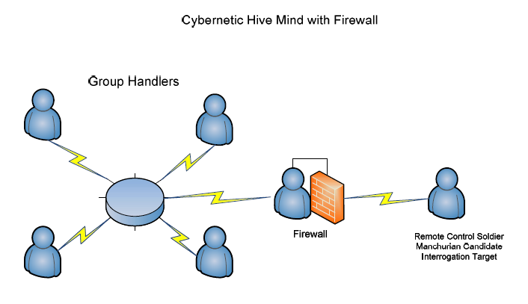
Hive Minds
Brain storming
Military Beowulf clusters
Targeting a mind with no firewall. Psychic Warfare.
Notes:
great at brain storming but also gives rise to schizophrenia (Latin “non-sequitur”, seeming non-logical flowing thought processes or it seems)
without a common cultural background and without common experiences, even language becomes irrelevant. Noam Chomsky linguist.
An example why the common person cannot understand torture unless they have experienced it
This means that the "mind" and sense of sense no longer is completely contained within the brain, a brain in a box, or a human in a sensory deprivation chamber. A world of possibilities are open.

Slide 7
What does it feel like?
Demonic possession, the holy ghost, alien abduction, or a kind of disassociation. Imagine Spock and a mind meld.
Voice hearers represent 5% of the population but only about 1% are affected negatively.
Loosing one’s senses, heterodyning, is exactly what we would expect from ESP.
MRI results of functional voice hearers and schizophrenics are nearly identical.
Targets have often described the experience as out of sync, multiple ideas and minds running on a single brain.
Notes:
It is often described as

Slide 8
Neurons
Notes:
This is the mathematic moment of the subjective feeling of "choice". Show summing potentials, sigmoid function, threshold, and depolarization.
{Nernst equation and conductance equation. Talk about mylenation with glial cells. The brain is both analogue and digital. Information is contained in the timings as well as the threshold strength structure. Intensity is represented by frequency of firings.}
Self organizing neural networks, resonance networks
focus of attention
counter intelligence research has focused on cognitive deception and error induction. Slight of mind to focus on the irrelevant. Example in nature, the fish with a tongue that looks like worm. The hypnotizing fish.
There are many ways to introduce an externally modulated signal into a neuron and neural networks. modulation of capacitance of the bi-lipid layer dialectric, modulation of the ion channels and voltage regulated channels, modulation of protein structures on cellular surface. Resistance volume and temperature. Space between synapses. Vibration pressure waves cause bio-chemical reactions to occur faster and slower. As long as the signal can be correlated and is coherent it will be learned by the brain. Synchronization (hypnotism and entrainment) is important for the signals to be interpreted by the brains. This should give researchers ideas of how to break the coherency of the external signal and the lock on to the target brain with entrainments

Slide 9
Structure
Notes:
Resonant, back-propagation, feedforward, and many others
Point of slide is to show how the brain never stops. The macro-circuit waves and why alignment (hypnosis and entrainment) is important plus the brain cells that act as clocking mechanisms with no input, ie. Dendrites. However if you can alter those neurons firing rates you can clock macrocircuits of the brain and synchronize the external signals where they learn each others patterns and share experiences. These synchronization neurons are attributed to the waking state and mostly controlled by hormones.

Slide 10
Structure cont.
Notes:
Notice the bias. This is one opportunity of the modulation of an externally coherent source. What symptoms might we see in Tis.? Sleep deprivation forced sleep from the excitation of these non-input self firing neurons. because these are regulated by hormones or other energies like microwaves a signal can be inserted into these micro and macro circuits. It is one answer of “Why torture targets”. Evil is a term used when one doesn’t understand the bigger picture. Is a lion evil for eating a deer? What you feel is betrayal of your own species. What are some possible good uses: perhaps you could awaken someone from a comma.
Changing the DNA expression to code for the ion channels both passive and active would alter the bias like increasing the attenuation of a radio receiver. This is unknown if it is done. Stress hormones may do this damage to the ionic channels thereby increasing influence of the external signal by attenuating or decreasing the natural internal signals from the senses. In consequence speeding up of the self organization nature of the networks to the external signal, another possible reason for torturing the target first.
One might ask about lag time between receivers and transmission.
Turns out this isn’t as big of a problem as you might think. At the speed of light there is only a tenth of a second to go around the world. The “gun shot heard around the world” in the American revolution would take 17 hours to reach the other side.

Slide 11
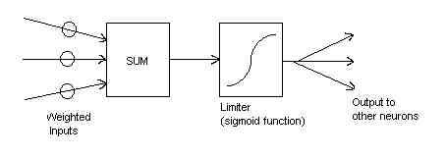
Biasing the Sigmoid Function
Notes:
What would happen if you lowered the threshold levels of all your neurons or similarly increasing the frequency of firing in the biasing neurons? What effects would you expect to see. Something like fibromyalgia, mania, or schizophrenia and sleep deprivation to name a few.
The threshold is determined by inhibitory neurons as well as excitatory dendritic growth as well as DNA protein generation.
The auto-firing nerve cells also act as a short term biasing mechanism.

Slide 12
Points of Influence and Attack in the Brain
Brain prints determine the uniqueness of minds
Passive ion channels and active ion pumps / organelles on cellular surface
Channel Density – DNA
EM Resonance
Pressure wave deformations
Release of neurotransmitters
Non-lethal weapons research
Notes:
neuron signal propagation, macro scale learning networks. "brain prints" of the mind, uniqueness. The brain is good at filtering out noise and amplification of recognition.
organelles on the cellular structure. Ultra sonic pressure waves, Fourier transform wave patterns in 3-d, microwaves - release of neurotransmitters non-lethal weapons, microwave hearing effect of tissue expansion. Show 2-d Fourier transform targeting two dots at multiple wavelengths slices. Time reverse echo, holography.
electric fields, magnetic fields, kinetic energy (heat), vibration (ultrasonic) cause conformational changes of cellular organelles like neurotransmitter release, signal induction changes like resistance voltage gradient and capacitance, ionic channels and even volumetric changes in the brain like with the microwave hearing effect, changes of resistance and synaptic distance. Bi-lipid breakdown of heat vibration and separation distance for the 10MV/meter gradient.
{observational evidence. Modulation of sound in background noise}. Dr. Becker in the Body Electric said the brain has a Q-factor of 3000.
Other observations. If brain was “amplified” you would expect a very talkative person. People with amplified brains would be good targets for the rewiring process. There are drugs which excite the brain and would be useful in the process. Also, question: Does there need to be a near field effect at first like neighbors in an apartment building to intensify the rewiring process at the beginning and then a less intense signal needed there after?
Sensory deception
Cognitive manipulation - often called PSYOPS, psychological operations
Hormone release and the heart are also electrical magnetic chemical systems too.
Nano bots are not feasible yet. Nano particles such as lead and mercury can influence neural function. Perhaps a permanently binding, artificial ion channel with narrow radio-frequency influence has been developed. I am against theories of nano-chips due to their susceptibility of EMP weapons.

Slide 13
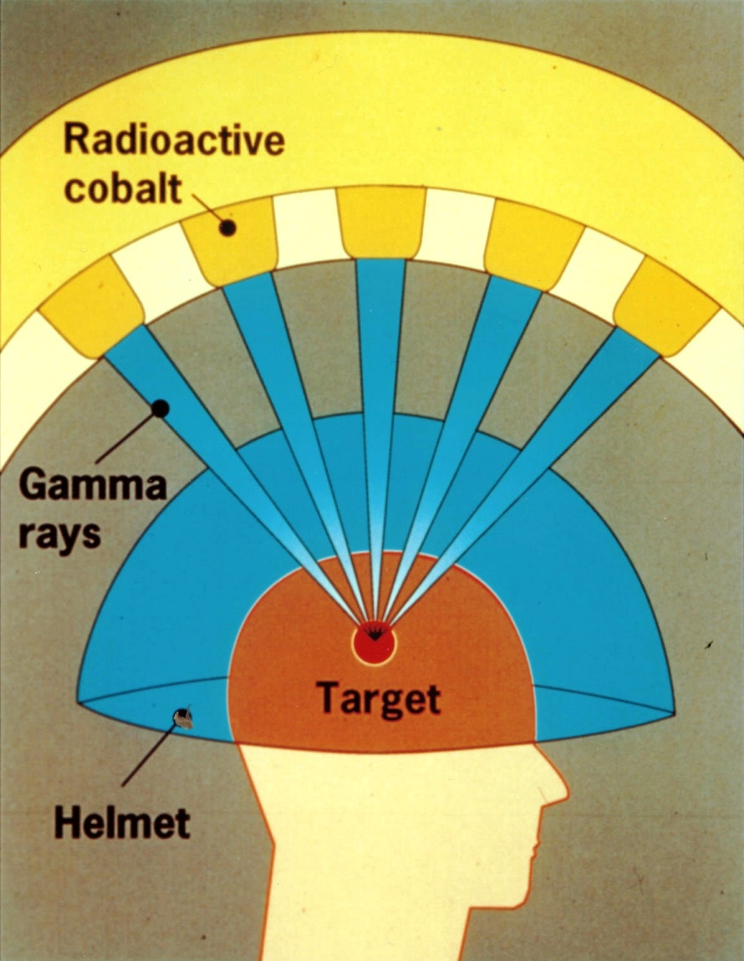
How can it be done?
Notes:
Gamma knife, Sony’s ultrasonic influencing systems.
intersecting circular waves would be directionally insensitive. multiple 2-d phased arrays can steer, shape, and determine the intensity at the intersection. This is called synthetic apertures and beam steering.
An interesting side note is that high powered ultraviolet or infrared lasers intersecting in 3-D would show a UFO like shape by exciting the Air molecules electron orbits. You would see a bluish saucer or cigar like shape depending on the directions of the intersecting lasers.
Using this technology you could make a spaceship appear and disappear in the sky, move at right angles, and jet away faster than the speed of light. But it is just a trick. The excitations would even appear on radar.
Even heat specific modulation could work like in the microwave hearing effect. Biochemical reactions operate at heat specific rates. Heat can be applied in very discrete packages.
This is symbolic information interjected into the information patterns of the brain and mind. Analogue to digital in neurons. In people it is multi-media download verses speaking and writing.
neural network properties, synaptic connection, and propagation structural speed.
Sensory deception.
Tangent- Time travel perception. Of course if one were in silicon form. Neat properties of transhumansm. Increase the perception speed of time while waiting at a doctor’s office. Or slow time down to dodge bullets like in the movie the matrix. Remember, this is subjective time dilation and has nothing to do with general relativity and the space time continuum. Star fish vs humming bird.
However to disable the target, only portions of the brain's microcircuits need to be signal analyzed and simulated
Under heterodyning all experiences from the external signal and the mind of the brain will be remembered and incorporated into the state changes of the brain
Factoid: The brain uses 20 watts (Stanford University) watts = voltage x current. If your brain energy usage were transferred into Light emitting diodes, we would be blinded in this room.
practically speaking isolation is best. It takes several months to begin the rewiring of the brain to begin to amplify the external signal. Do they have to start with a near field?
ideas for jamming
Defense ideas: interfere with signal. add noise. Dampen. Sensory stimuli. Jam signal going into brain or jam return signal of sensors.
Because only emotions and speech, smells, touch, and taste, hearing and vision can be projected, trauma based conditioning is another time tested way to indoctrinate a human robot into armies and such.
Trauma based conditioning methods are the easy way to differentiate naturally occurring mental illness from government sponsored.
TO hide their identity they use confusion tactics and false flag methods
NLP and other methods are used to "teach" the human behavior of interest for the handlers.
Side note: “Why does some passive shielding appear not to show improvement?” Because the brain learned the responses. This allows for durations with no external signal but the brain will respond to the previously learned patterns. Also, no one method blocks all energy. The methods of attack can happen over an entire spectrum and we will look at those next.

Slide 14
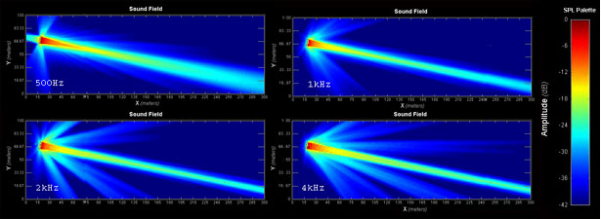
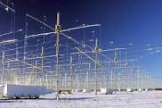
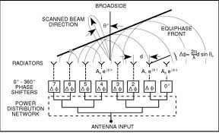
Beam Steering and Phased Arrays
Notes:
I remember a couple stories from my past. Remember I was just a scientists for the agencies, I was never an operational agent. I was given a cover story for this particular mission. I was to say to the foreign country that I was a marine biologist. I was in an underground secret base working on the AI software to track all objects that make passive sound around the oceans. I asked for some more sample sets of Russian submarines for signature analysis. They almost caused an international incident to get me the data. This is how they think. I also heard 14 admirals from NATO joke that they made congress give them billions to “track whales” and then they all laughed. You have to understand the mentalities doing this to the public. Their sonar experiments cause whales to beach themselves.
Beam forming is the reverse of beam steering. It is reading versus directing energy.
What is directed energy? Resonance and absorption. Even buildings swaying is a type of directed energy.
Think of colors and which color reflects light verses absorbs it. Human bodies and brain resonances are similar.
This idea made Tesla famous with his demonstrations with lights.

Slide 15
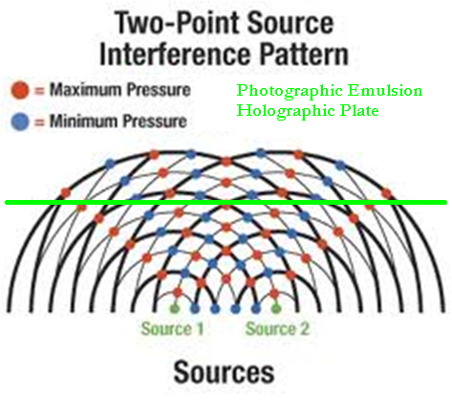
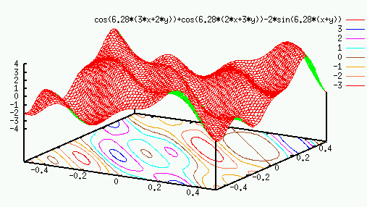
Holography and 3-D Beams
Notes:
This is to help you understand why so many people can be targeted simultaneously in 3-space using just a few intersecting 2-D phased arrays.
Holography is often a misused term.
Time reverse echo is a term used in accoustics.

Slide 16
Creating a Super Soldier
Heightened awareness and senses
Faster reflexes
Photographic memory
Hive mind organization
Synthetic telepathy
Hardened by SERE for psychics
Torture immunization
Compartmentalized communication networks
Notes:
Heightened awareness and senses, photographic memory, faster reflexes
Synthetic telepathy communication, acting in a organized hive mind
Also to toughen up so "secrets" can't slip. SERE for psychics. Torture immunization. Harden them so they won't talk.compartmentalisation. A vessel for communication to those not on the network.
Truth serum.

Slide 17
The Big Picture
Notes:
This is a mathematician’s language of morality. Goals of the individual, population, trans-generational, species. Sustainability is trans-generational. Goals optimize happiness and alleviate suffering.
Maybe our goal is to progress in knowledge and exploration. Maybe to expand life into the galaxy. But this equation is a good goal.
Optimizing happiness might include optimizing longevity or maybe not. Politics is about the debate to optimize this equation. The function of happiness and misery has many complex unknown variables. Environmentalist focus on sustainability and empathy (the outermost optimization factors). Capitalists focus on the inner most.
optimizing a local group, individuals, lifetime happiness often relies on resources and belief systems which need groups. This is where soldiers are necessary. Flocks, herds, packs are seen in all animal species behaviors. It optimizes survival strategies.
Food, wealth, power, oil, land, mating rights, aversion to change of culture, etc are the usual motivators for conflict and war
We have been Borg'ed since birth - The Collective. Resistance is futile. You will be assimilated.
language culture and customs. Religions, beliefs, values, and traditions.
snail mail, telegraph, telephone, mobile phone, internet - it is called the bluing of information. The reason is the fiber optic wavelength. High frequencies can contain more information.
we are the nodes of a larger hive mind living on the crust of this planet. The next stage of our technological evolution is accessing the internet and each other at the speed of thought.
inherently we value our humanity, individuality, and freedom. It appears that in the next 50 years we will have lost both. However by increasing intelligence a 100 fold we may no longer be human we may have more freedom of thought and not constrained by the biological brain and its 100 billion neuron processors and its 100 trillion synaptic connection. That’s about an average of 1000 connections per neurons.
Creativity vs. conformity (one can think of this as the mutation rate of MEMES in a society) predictability vs catastrophic paradigm shifts)
Cultural war, monkey see monkey do. Why do firefly in groups all blink at the same time? What if someone had the goal of conforming the human race using signals that would entrain 7 billion people on Earth for this goal of behavior normalization?

Slide 18
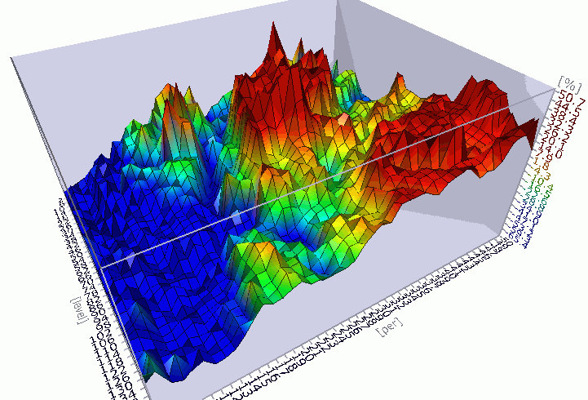
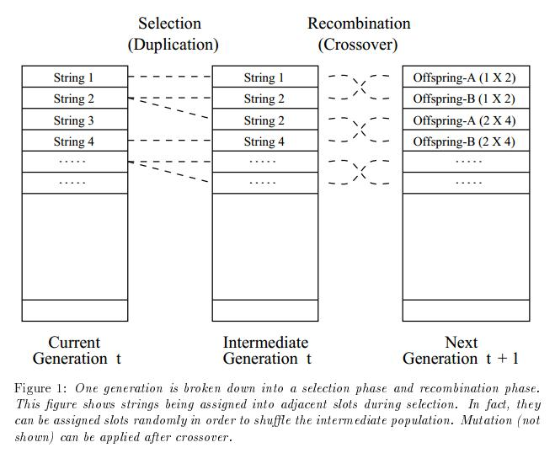
Emergent Minds
Genetic Algorithms:
Mutation&Crossover
Notes:
much of the research in AI is creating minds that this planet has never seen using our understanding of intelligence
Why use genetic algorithms and neural networks? It has to do with convergence onto a globally optimal solution in a very complex non-linear solution space.
monkeys that can control a 3rd robotic limb. There are mice who have an artificial hypocampus which has been identified to be involved in memory. It can be put in another mouse and it has its memories.
as a member of society and its collective the question is "what is your function?"
as a neural subnetwork in the human brain the question is "what is your purpose?"
Marvin Minsky, an MIT professor describes "The society of minds" within our own mind. Ask a TI who lost their sense of self.
What gives rise to the sense of self? People under heterodyning or cloning do not experience a whole, gestalt, sense of self.

Slide 19
Genetic algorithms and neural networks
Notes:
Mankind created the modern day dog with selective breeding, probably one of the most loving and perfect creatures on Earth. What happens if we create our intellectual superior that doesn’t need sleep or love, we they keep us around as pets? With all advancements, there is great potential for the improvement of life or the peril that we are enslaved or eliminated. We must stay vigilant and discuss the morality of what we do before it is too late.

Slide 20
End of Presentation
sensory data -> information (processed data) -> knowledge (accumulated life learning) -> wisdom (generational knowledge) -> ascension (immortal and a program which can run on anything in all timeframes)
Ascend
Notes:
Remember that consciousness is the software and can run on anything as long as it has complexity, adapts, and evolves. It must have structure and many specialized components.
Our experience in this short time frame on this planet derives from this model.
Let's go forth and feed these fragile physical bodies while we wait to ascend into beings of light

